Slide 1
Case Study :EShoppingZone
By: Shivam Kumar Gupta

Slide 2
Technology Used
Backend
Spring
Swagger
Api Gateway
Eureka Server
Razor Pay Gateway
Front-end
React
React-bootstrap
Database
MongoDB

Slide 3
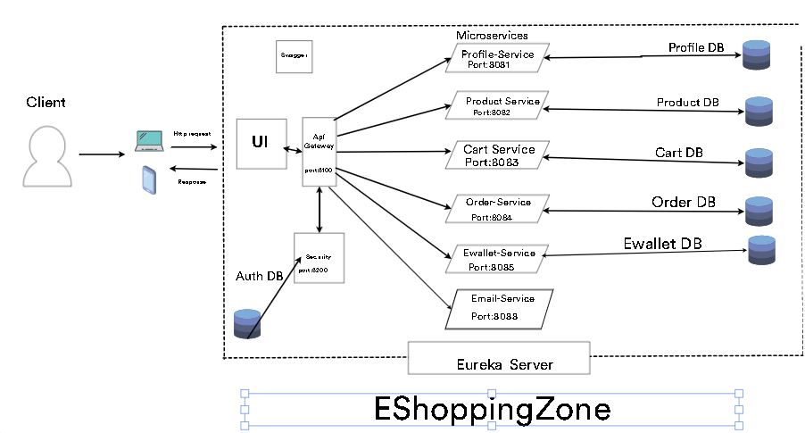
Email- Service

